Slide 1
Determination of TNO detection efficiency using Machine Learning
By Vincent FORIEL & Jean-Marc PETIT

Slide 2
Contents
Context
Data processing
First steps in Machine Learning
Scaling of the data set
K-fold cross validation & genetic algorithm
Fresh news
Conclusion

Slide 3
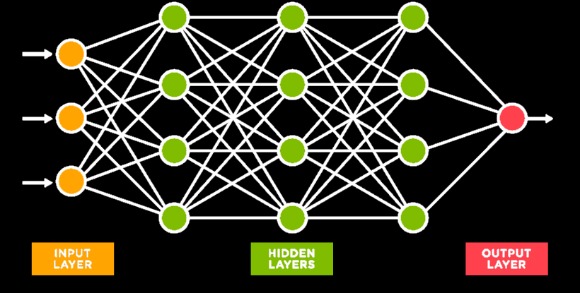
First steps in Machine Learning

Slide 4
Evolution of accuracy over scaling

Slide 5
Evolution of accuracy over generations

Slide 6
Evolution of accuracy over scaling

